Slide 1
MA1506 Mathematics II
Chapter 7
Systems of First Order ODEs

Slide 2
7.1 Solving Linear System of ODEs
How to solve
a,b,c,d constants
i.e,
We shall look at an old problem,
which is related to our new problem,
to get ideas to solve our new problem

Slide 3
An old problem
7.1 Solving System of ODEs
Consider
Zero function
is a solution
However we are interested in nonzero solutions
We know that
is the general solution , where
is any constant
If we want nonzero solutions, then we assume
that
is nonzero constant

Slide 4
7.1 Solving System of ODEs
So solutions of the old problem are of the
form
Solutions of systems of ODE
From this old problem, we may guess that
solutions of
are of the form
which can be written as

Slide 5
7.1 Solving System of ODEs
Now we shall find
How to find? First substitute
into the given ODE,
Note that

Slide 6
7.1 Solving System of ODEs
where
Let
We get
number
2x2 matrix
We can not apply cancellation rule to the above equality

Slide 7
7.1 Solving System of ODEs
Rewrite
as
where
Hence we have
We want nonzero solns of the given ODE,
so we want
to be nonzero vector
Therefore
from Chapter 5, Section 5.5.

Slide 8
7.1 Solving System of ODEs
Before we look at
We shall look at the following equality carefully
This equality can be written as
eigenvector
eigenvalue
So we are looking for eigenvalues
and eigenvectors of B

Slide 9
7.1 Solving System of ODEs
Hence
Thus
Eigenvalue
Recall

Slide 10
There are three cases
7.1 Solving System of ODEs
Case 1: Two distinct real roots (eigenvalues)
i.e.,
Suppose two distinct real eigenvalues are
Then find the corresponding eigenvectors
by
We have two (linearly independent) solutions
and

Slide 11
7.1 Solving System of ODEs
The general solution is
…..(C1)
where
are any real numbers

Slide 12
Case 2: Two complex roots (eigenvalues)
7.1 Solving System of ODEs
i.e.,
If one complex eigenvalue is
then the 2nd complex eigenvalue is
which is the conjugate of
Consider complex eigenvalue
The corresponding complex eigenvector w=u+iv
is given by

Slide 13
7.1 Solving System of ODEs
Then
is a solution
However it is a complex-valued .
We want real-valued solutions
We can get two (linearly indep) real solutions from
this complex-valued solution.
How?

Slide 14
7.1 Solving System of ODEs
Real part of the complex solution
and imaginary part of the complex solution
are two real-valued (linearly indep) solutions
The general solution is
…..(C2)
are any real numbers

Slide 15
Do we need to consider
7.1 Solving System of ODEs
ANS: NO
Since it will induce the same general
solution
Note:
eigenvalue
eigenvector

Slide 16
Case 3: Only one real root (eigenvalue)
7.1 Solving System of ODEs
i.e.,
we skip this case in this module

Slide 17
7.1 Solving System of ODEs
Examples
Solve
(1)
Eigenvalues are
Corresponding eigenvectors are

Slide 18
7.1 Solving System of ODEs
Cont.
The general solution is
i.e.,

Slide 19
7.1 Solving System of ODEs
(2)
Eigenvalues are
Need only to consider
The corresponding eigenvector is

Slide 20
7.1 Solving System of ODEs
Cont.
The general solution is
Refer to Case 2 solution (C2)

Slide 21
Solving system of ODE by Laplace transform
Let
We shall use the following notations
Solve the following system of ODE

Slide 22
Apply Laplace transform to
get
Similar to
we have
Hence

Slide 23
So
Suppose
Then

Slide 24
Hence

Slide 26
Hence
Thus

Slide 27
Remark:
7.1 Solving System of ODEs
i.e.,
Recall 1-dim case
The above two-dimensional 1st order
homogeneous linear system of ODE with
constant coefficients always has TWO
linearly indep (nonparallel) solutions, say
u and v.
cu+dv is again a solution.
Any soln is of this form. Here c and d are any real numbers

Slide 28
Remark: 2nd order ODE is a special case of systems of ODE
7.1 Solving System of ODEs
Solutions of
is same as solutions of
See next slide for proof

Slide 29
From the above ODE in matrix form, we get
7.1 Solving System of ODEs
Hence from above
two equations, get
So

Slide 30
7.2 Stability of equilibrium solution
Consider a system of ODE
A soln of the above ODE is said to be an
equilibrium soln(equilibrium point) if it is a constant function (see Chapter 2)
For example, zero
is always a solution, so zero is an equilibrium soln

Slide 31
Are there other constant solutions?
7.2 Stability of equilibrium
For some cases, we may have other
constant solutions
For example, when
Eigenvalues are
The general soln is
(See Case 1 in 7.1)

Slide 32
7.2 Stability of equilibrium
Hence
is a soln, which is constant
is any real number
So we have many constant solns
However , in this section, for convenience,
we assume that
is the only constant soln
Equivalently, we assume that
inverse of B exists
i.e., we only have ONE equilibrium solution

Slide 33
7.2 Stability of equilibrium
An equilibrium soln (point) is said to be stable
if any soln with an initial point close to the
equilibrium soln stays close to the
equilibrium soln (point)
Now we shall discuss stability of equilibrium soln of Case1 and Case 2 in 7.1.
We shall not discuss Case 3 and zero eiganvalue
You may refer to text book Chapter 6 for Case 3
(optional)

Slide 34
7.2 Stability of equilibrium
Recall: eigenvalues are given by
Case 1
Two real eigenvalues
The general soln is
We can feel that zero equilibrium soln is stable
iff two eigenvalues are less than or equal to zero

Slide 35
7.2 Stability of equilibrium
Case 1
From
we know that two eigenvalues are less than or equal to zero iff
suppose
Then
Contrad.

Slide 36
7.2 Stability of equilibrium
Hence for Case 1:
Zero equilibrium soln is stable iff
and
Note: In fact
since we assume that inverse of B exits, so

Slide 37
Case 2: Two complex eigenvalues
7.2 Stability of equilibrium
The general soln is
where
(See Case 2 in 7.1)

Slide 38
7.2 Stability of equilibrium
Hence zero equilibrium soln is stable iff
i.e.,
Note that in this case
So

Slide 39
For Case1 and Case 2
7.2 Stability of equilibrium
unstable
stable
For case1
Dash line
unstable
unstable
We will say more about unstable cases in next section

Slide 40
7.3 Phase plane and classification of zero solution
A solution of a 2-dim system of ODE is given by
In this section, a phase plane is a x(t)-y(t) plane
The trajectories in the phase plane are
the parametric curves described by x(t) and y(t)
Trajectories on a phase plane
create a phase portrait

Slide 41
7.3 Phase plane
Phase planes are useful in visualizing
the behavior (including stability of equilibrium soln) of physical system.
Again we shall only consider
Case1 and Case 2 in 7.1
We shall not consider Case 3
You may refer to text book Chapter 6 for Case 3
(optional)

Slide 42
Case 1: Two real eigenvalues
7.3 Phase plane
The general soln is
eigenvector
eigenvector
First note that if
we have
So

Slide 43
7.3 Phase plane
Hence the st. line through 0 with gradient h/g
is one of trajectories in the phase plane
Recall
So the gradient of this st. line equals to the gradient of the eigenvector
We should have two basic trajectories
induced by two eigenvectors

Slide 44
7.3 Phase plane
Examples
(1)Two negative eigenvalues
Eigenvalues are
Corresponding Eigenvectors are

Slide 45
7.3 Phase plane
Two basic trajectories induced by two eigenvectors
Trajectories
tend to zero
since solns
tend to zero
as t tends to infinity
Corresponding to eigenvalue -3
○
Trajectories tend
to zero, but never
reach zero
Corresponding to eigenvalue -1

Slide 46
7.3 Phase plane
Trajectories tend to zero, but never reach zero
Why?
By
no crossing principle
(See chapter 3)
Zero function is a soln, a trajectory is a soln,
“no crossing principle” can be applied here
Next we shall keep using no crossing principle
to sketch other trajectories

Slide 47
7.3 Phase plane
All trajectories
tend to zero
since solns
tend to zero
as t tends to infinity
Corresp to bigger eigenvalue -1
No crossing for
trajectories
All trajectories tend
to zero, but never
reach zero
○
Gradient of every
trajectory near zero
is almost equal to 1
Equilibrium soln zero
is stable
For this case ,
zero is called
a nodal sink
Proof next slide
Gradient of
bigger eigenvector

Slide 48
7.3 Phase plane
Proof of
To have general idea, we write
=gradient of eigenvector with bigger eigenvalue

Slide 49
7.3 Phase plane
Remark: Trajectories (x(t),y(t))
(not parallel to eigenvectors)
are tangent to the eigenvector
with bigger eigenvalue
Trajectory according
to eigenvector
Web Application
http://www.aw-bc.com/ide/idefiles/media/JavaTools/lnclmtrx.html

Slide 50
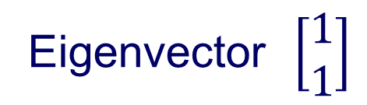
Another Example:
7.3 Phase plane
Eigenvector $\left[\begin{matrix}1 \\ 1\end{matrix}\right]$
has eigenvalue -1 which is bigger

Slide 51
7.3 Phase plane
Trajectories (not parallel to eigenvectors)
are tangent to eigenvector with bigger eigenvalue near pt zero
has eigenvalue -1 which is bigger

Slide 52
In general, suppose two eigenvalues are negative
Web Application
7.3 Phase plane
http://www.aw-bc.com/ide/idefiles/media/JavaTools/lnclmtrx.html
Then the phase portrait is similar to the
previous example.
All trajectories (not parallel to eigenvectors)
are tangent, near zero, to the eigenvector
corresponding to bigger eigenvalue

Slide 53
7.3 Phase plane
(2) Two positive eigenvalues
Eigenvalues are 2, 1
Eigenvectors are
Two eigenvectors induce two basic trajectories,
namely, x-axis and y-axis
General soln is

Slide 54
Let
= the gradient of eigenvector
with bigger eigenvalue
So tangents of all trajectories
(not parallel to eigenvectors),
are almost horizontal, when t tends to infinity .

Slide 55
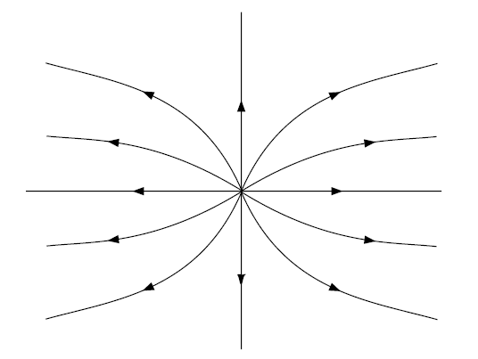
7.3 Phase plane
All trajectories never touch zero
No crossing for trajectories
All trajectories tend to infinity
as t tends to infinity
Zero is called nodal Source
Equilibrium soln zero
is unstable
●
with bigger eigenvalue
Tangents of all trajectories
(not parallel to eigenvectors),
are almost horizontal,
when t tends to infinity

Slide 56
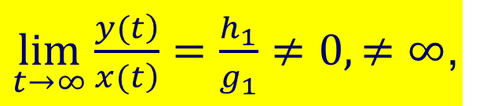
Web Application
7.3 Phase plane
If
$\lim_{t→∞}\frac{\left.y(t\right)}{\left.x(t\right)}=\frac{h_{1}}{g_{1}}≠0,≠∞$,
then
all trajectories (not parallel to eigenvectors),
when t tends to infinity ,are tangent to the
eigenvector
with bigger eigenvalue
http://www.aw-bc.com/ide/idefiles/media/JavaTools/lnclmtrx.html

Slide 57
(3) Two real eigenvalues with opposite signs
7.3 Phase plane
Suppose we have eigenvectors as follows
Corresponding to negative eigenvalue
Corresponding to positive eigenvalue

Slide 58
7.3 Phase plane
Hence we have two basic trajectories
induced by eigenvectors as follows

Slide 59
When t large, trajectories
tangent to the trajectory
induced by
bigger eigenvalue i.e., positive
eigenvalue

Slide 60
7.3 Phase plane
By no crossing principle, we can
sketch trajectories as follows
Zero is called a saddle point
All trajectories never touch zero
Equilibrium soln zero
is not stable
No crossing for trajectories
When t large, trajectories
tangent to the trajectory
induced by
bigger eigenvalue
●
bigger eigenvalue
Most of trajectories away from equilibrium. In fact, all except one

Slide 61
Web Application
7.3 Phase plane
http://www.aw-bc.com/ide/idefiles/media/JavaTools/lnclmtrx.html

Slide 62
7.3 Phase plane
Classification of zero solution
Summary of Case 1
Two Real Eigenvalues
Opp signs : Saddle
Both > 0 : Nodal source
Both < 0 : Nodal sink
Next we shall use
to classify the above three cases,
which is easier

Slide 63
Eigenvalues are given by
7.3 Phase plane
Real roots
Then from above , we have (proof omitted)
Nodal Source Both > 0
Nodal Sink Both < 0
Saddle Opp Signs
Recall: we do not discuss zero eigenvector

Slide 64
Case 2: Complex Eigenvalues
7.3 Phase plane
The general solution is
Rotating
involving angle
βt
Stretch / Shrink see following slides

Slide 65
(1)
Spiral Sink: (Clockwise or anticlockwise)
Trajectories spiraling towards equilibrium soln zero

Slide 66
(2)
2) Spiral Source: (Clockwise or anticlockwise)
Trajectories spiraling away from equilibrium soln zero

Slide 67
(3)
Centre
Clockwise or anticlockwise
discuss soon
Trajectories orbiting around equilibrium soln zero

Slide 68
7.3 Phase plane
Classification of zero solution (cont.)
SUMMARY of Case 2
Complex eigenvalues
Spiral Source
Spiral Sink
Centre

Slide 69
How to determine clockwise or anticlockwise
7.3 Phase plane
We shall use one example to illustrate it
Example:
Complex Eigenvalues

Slide 70
7.3 Phase plane
Spiral Source
In the above, which one we shall choose

Slide 71
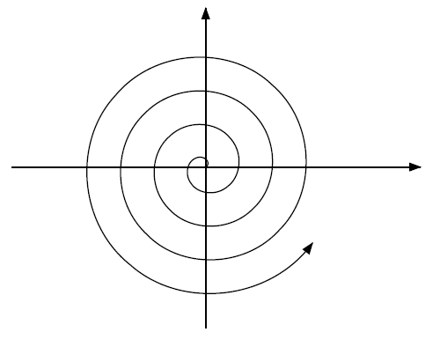
7.3 Phase plane
How to determine clockwise or anticlockwise
It means, near the positive x-axis, the value of y
increases;
near the negative x-axis, the value of y decreases
Hence anticlockwise
Why choose y=0 and x-axis?
ANS: convenient

Slide 72
7.3 Phase plane
We may also look at
It means, near the positive y-axis, the value of x
decreases;
near the negative y-axis, the value of x increases
Hence anticlockwise
The graph just indicates
zero is a spiral source
anticlockwise, for more
precise graph, see next slide

Slide 73
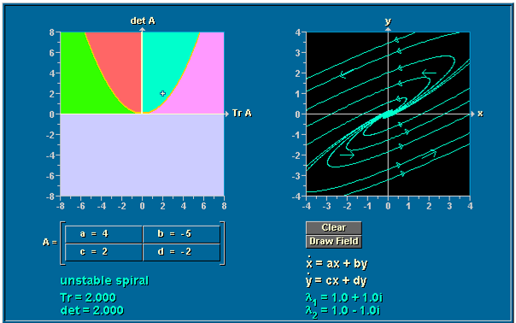
7.3 Phase plane
Web Application
http://www.aw-bc.com/ide/idefiles/media/JavaTools/lnclmtrx.html

Slide 74
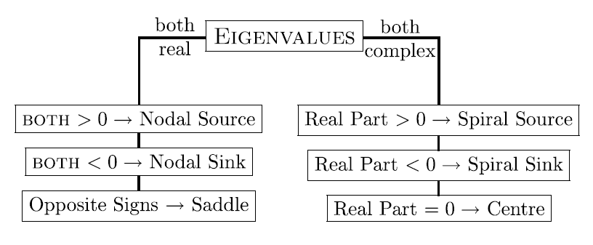
Summary
Classification of zero solution
7.3 Phase plane
Method 1: Find Eigenvalues

Slide 75
7.3 Phase plane
Method 2:
2nd method is easier

Slide 76
7.4 Romeo and Juliet
The story of Romeo and Juliet in this module
is different from Shakespeare’s
R(t), Romeo’s feelings J(t), Juliet’s feelings
a, b >0
The above system of equations says that
Romeo’s love grows in proportion to Juliet’s
love for him
Juliet’s love decreases in proportion to Romeo’s
love for her
How does the relationship evolve?

Slide 77
7.4 Romeo and Juliet
We shall not solve this ODE,
only look at the phase plane,
Complex eigenvalues

Slide 78
7.4 Romeo and Juliet
phase plane
CENTRE
J
●
R
Clockwise since
●
Therefore at red point , R is increasing

Slide 79
7.4 Romeo and Juliet
Phase plane
CENTRE
R’ love increases,
J’s love decreases
R’ hate decreases,
J’s love increases
J
R
R’s hate increases
J’ hate decreases,
J’ hate increases ,
R’s love decreases

Slide 80
Web Application
7.4 Romeo and Juliet
http://www.aw-bc.com/ide/idefiles/media/JavaTools/lnclmtrx.html

Slide 81
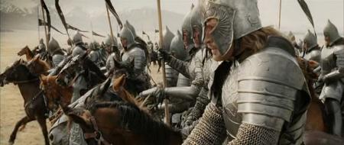
7.5 Warfare
7.5. Warfare
G(t)= # of Gondorians
M(t)= # of Mordorians
G(0)=15000
M(0)= 11000

Slide 82
7.5. Warfare
The above equation says Mordorians die
(killed by Gondorians) at a rate
proportional to the number of Gondorians
Rewrite the above eq as
Suppose unit of t is one day.
More precisely, the above equation says
every Gondorian kills one Mordorian per day.

Slide 83
7.5. Warfare
The above equation says one Mordorian kills 0.75 Gondorians per day
The death rate per capita of Gondorians
due to disease is 1
We shall not solve this ODE,
only look at the phase plane

Slide 84
7.5. Warfare
Saddle
Eigenvalues
1/2
-3/2
induce two
basic trajectories
Eigenvectors

Slide 85
7.5. Warfare
1/2
M
-3/2
induces
induces
This trajectory tends to infinity
since eigenvalue is positive
This trajectory
tends to 0
since eigenvalue
is negative
●
M will win
This trajectory is very crucial
●
●
G
All will be killed
G will win

Slide 86
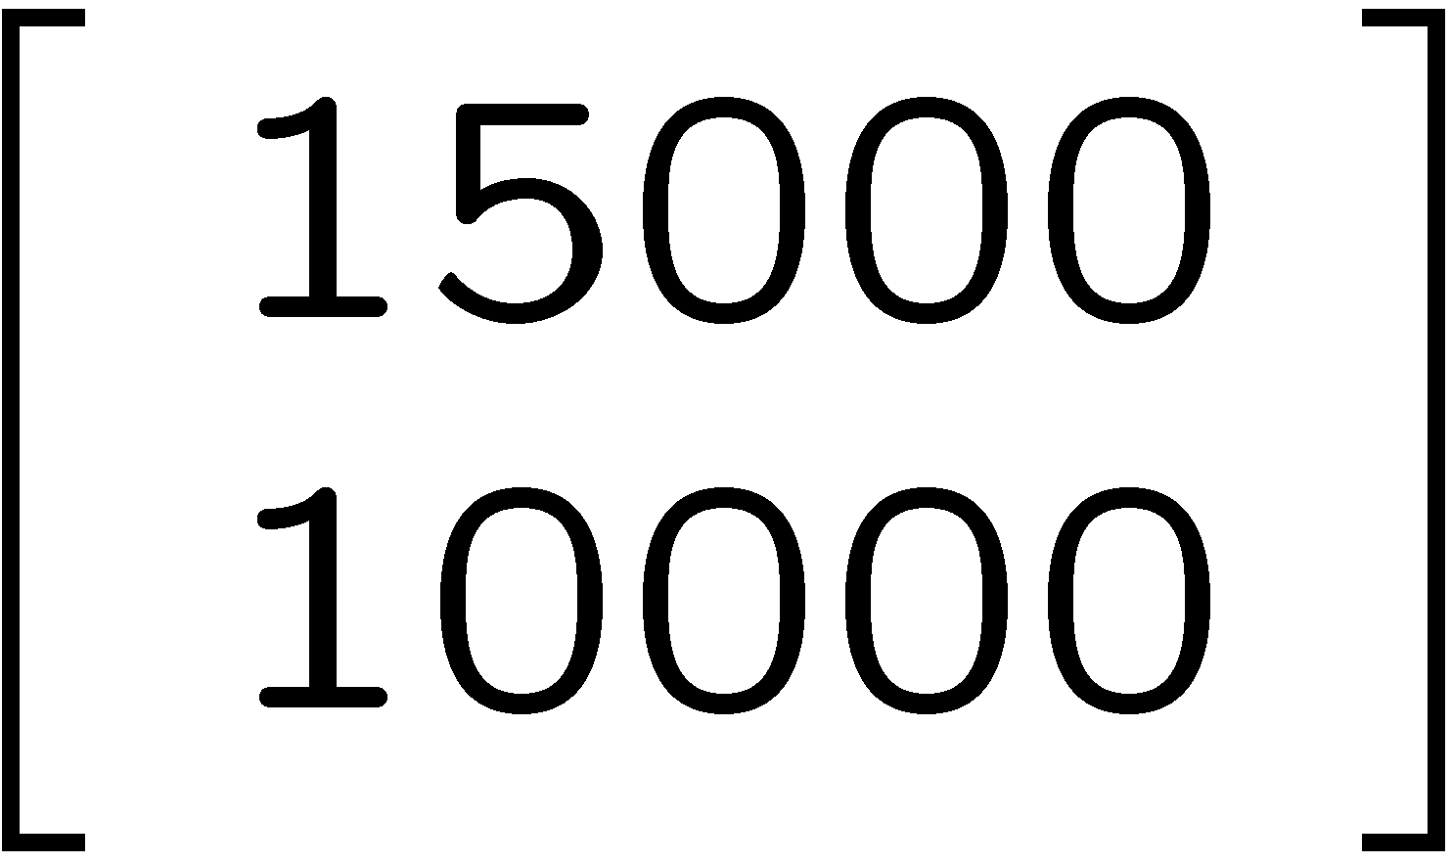
7.5. Warfare
Suppose G(0)=15000 is fixed
Then min M(0) that M will
win is 10001
M
●
M will win
●
●
G
All will be killed
G will win

Slide 87
7.5. Warfare
Suppose M(0)=10000 is fixed
Then min G(0) that G will win
is 15001
M
●
M will win
●
●
G
All will be killed
G will win
End
Chapter 7

